Slide 1
GOOGLE PLAY STORE ANALYSIS BY: Hermineh Yeghikian

Slide 2
DATA OVERVIEW
APPS
9659
CATEGORIES
33
CONTENT RATING
teen
unrated
17+
everyone 10+
adults only 18+
TYPE OF DOWNLOAD
Free
Paid
SIZE OF THE APP
Ranges from 1.0 M-975K

Slide 3
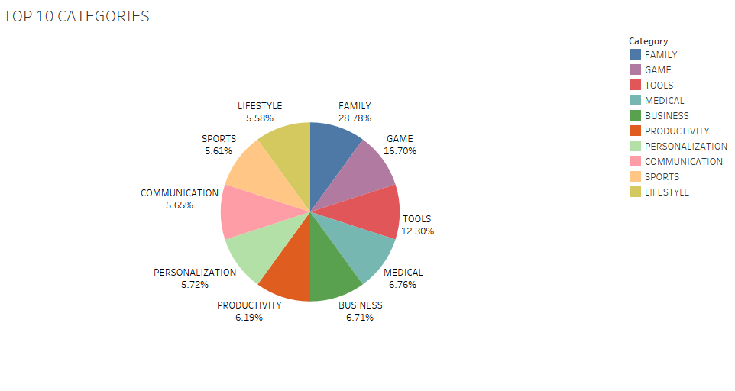

Slide 4
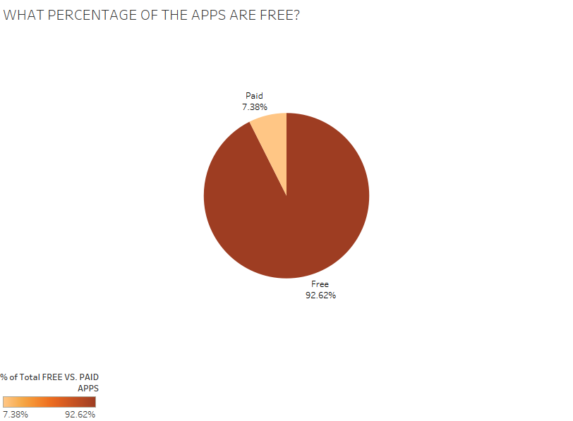

Slide 5
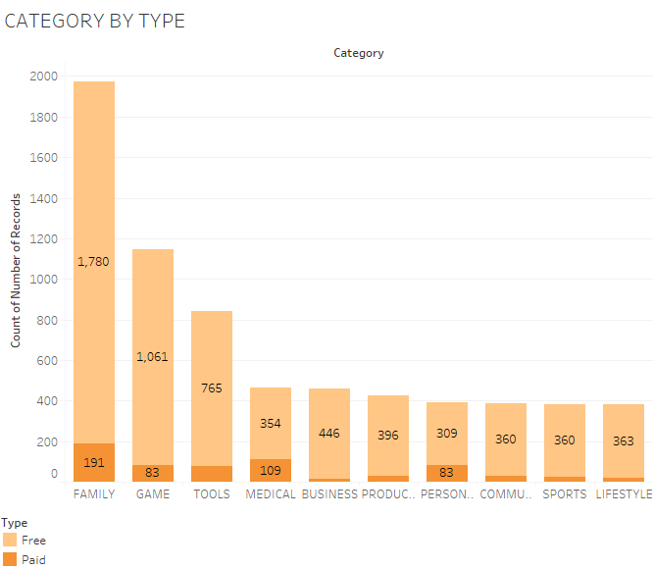

Slide 6
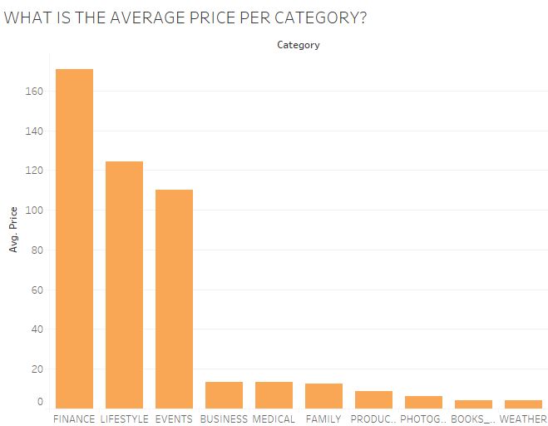

Slide 7
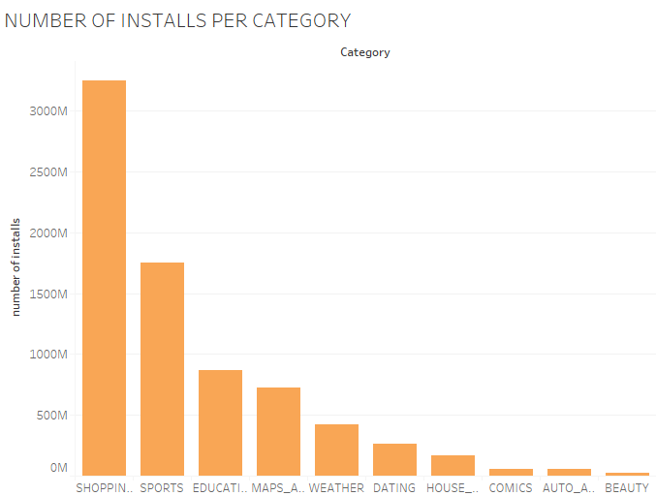

Slide 8
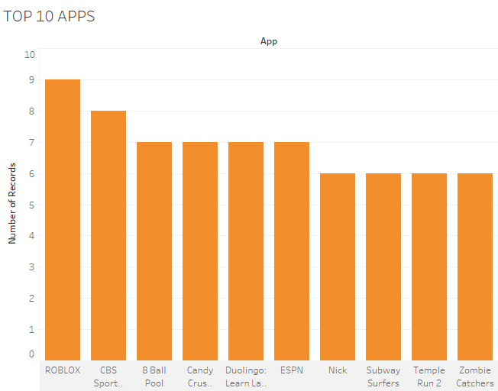

Slide 9
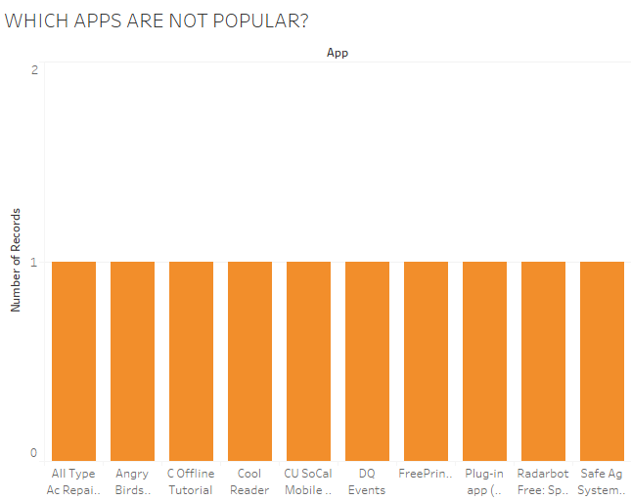

Slide 10
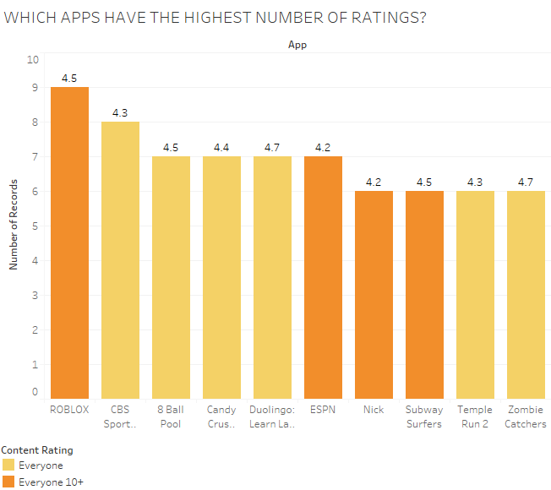

Slide 11
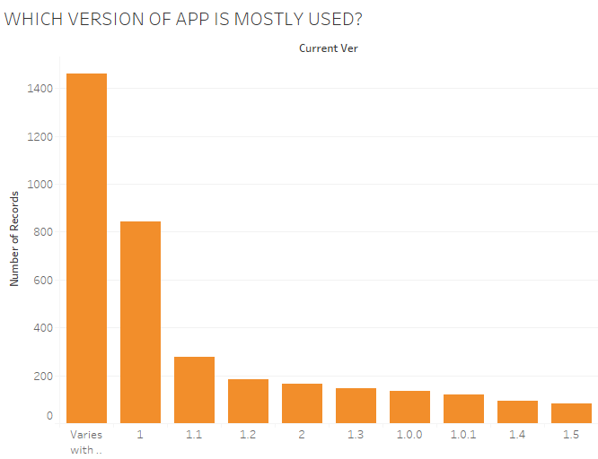

Slide 12
RESULTS
The most popular category is family, which is about 28.78%
Game is the second most popular about 16.7%
The least popular category downloaded is lifestyle, about 5.58%
By type
About 1780 downloads for family are free
191 are paid
Average price
On average, $165 is spent on finance
$10 is spent on weather
Installs per category
As an estimate, category “shopping” has about 3500 installs
The least amount of installs is “beauty”
Most popular app
The most popular app is Roblox
The least popular app has only 1 download
Ratings of apps
Roblox has the most amount of rating of 4.5 that is rated by everyone aged 10+
Current version
Mostly used is varies with device

Slide 13
Recommendation & future analysis
Don’t develop an app that people installs the least
Work on the least popular apps by changing things around to try to make it better
Develop apps that have in app purchases to make a profit
Focus on which apps has the most amount of ratings
For future analysis
Gather data for user information, such as the age group that is installing the app
Gather data for each country to see in which country, people download the most apps
Compare Android apps to iphone apps, to analyze which apps are downloaded the most

